Slide 1
Safe Family Linked Services
Creating worry-free solutions for vulnerable family members.

Slide 2
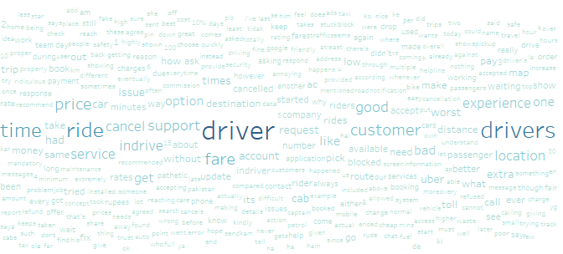


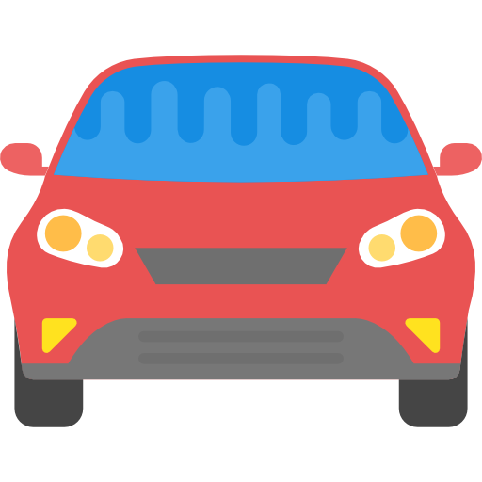

Customers’ Complaints
We do text mining from customers’ comments which gave score 1 or 2 in the rating, and we get some main issues:
Driver
Price/ fare
Car condition
From Google Apps review, the driver is the most complained topics, while safety is only mentioned several times, the users complained about safety driving and tracking doesnt work.
Cancellation

Slide 3
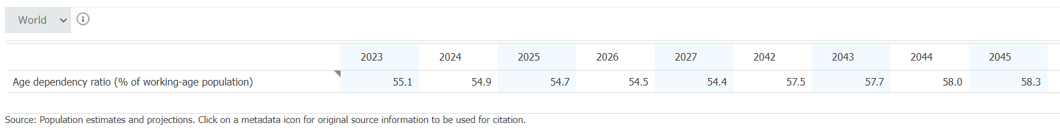
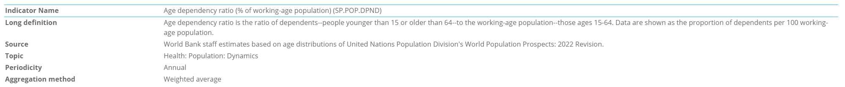
Dependency Ratios (World Bank)
From 2027 forwards, the dependency ratio (age <15y.o. And >64y.o. compared to working age of 15-64 y.o.) will be increasing. It means the potential user base will be need an assistance and protection from the working age people is growing bigger.

Slide 4
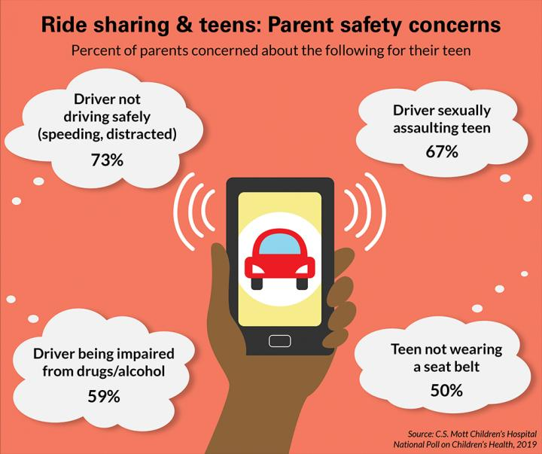
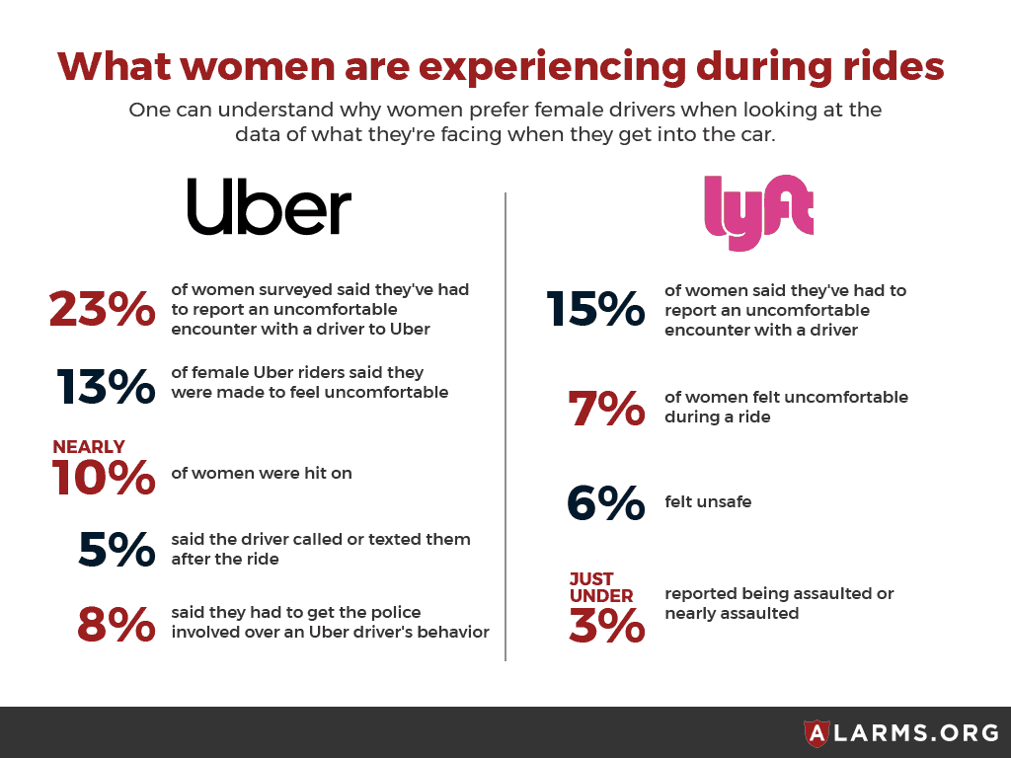
Ride Hailing Safety
Ride Hailing safety is a big concern especially for parents who order the service for their underage kids, and this is also applied with adult/ From Alarms.org 23% on Uber reported uncomfortable behaviour of the driver.

Slide 5
Safety Concern Use Cases
01
02
03
04
Under 18 Passenger
School Commutes
Under 18 passenger can’t register to the Services, needs adult to order, don’t have control over the apps.
Usually junior high school or younger with busy parents will hiring service for their kids commute, not owning a phone.
Medical Emergency
Woman Alone
People (especially old people) can’t order services to go to the hospital, and far away from their family.
Women is vulnerable from bad driver as mentioned in the slide before.

Slide 6
Our Solution
Safe Family Linked Services
Linked Apps
Driver ID & Rate-Based Fee
GPS Track
Safe Features
The apps can be linked to the other apps via authentification.
The apps will authorized driver ID to the parents/guardian.
Can be tracked with the apps, or IoT with GPS enabled feature.
Creating safety features, like QR Code Landing, and Scheduled Ride.

Slide 7
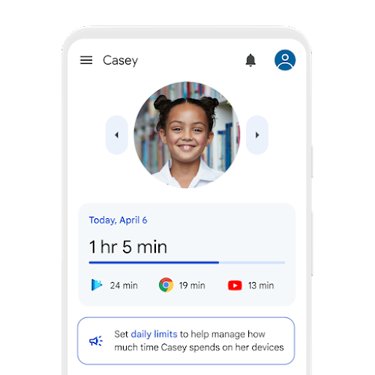
01 Family Linked Apps
SFLS enabled the users to linked their Apps to each other's with consent and approval, this module kinda like the Family Link from Google where the parent can monitor theiir children phone activities.
This could help people to book a ride for their kids, old people, or vulnerable family as well as monitoring their safety.
Went to school 08.30
Arrived at school 08.45
Book Ride for Casey

Slide 8
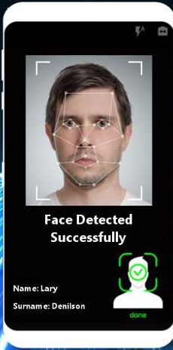
02 Driver ID Verification & Rate-Based Fee
This module will helps to verify the driver ID via Face and Car ID verification
Drivers will be paid based on their rating, the drivers whose rating are higher can claim higher fee. It will encourage the drivers to perform better.
Name : Andy
Car ID : 123 XYZ

Slide 9
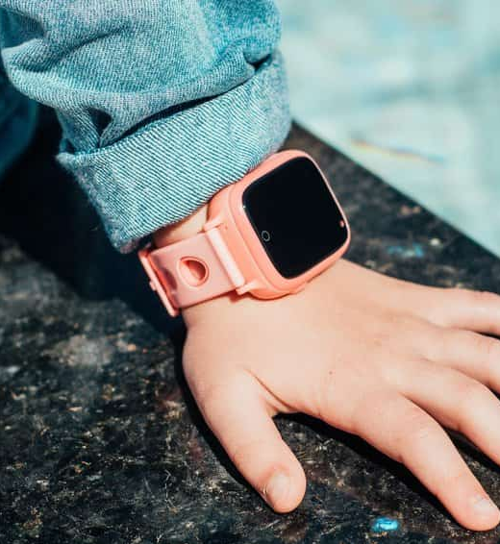
03 GPS Tracked
Went to school 08.30
Arrived at school 08.45
Book Ride for Casey
By Linked Apps
IoT (Smartwatch)
Tell the live location of linked family members through apps, and also tell about their location history.
GPS can e tracked by smartwatch for kids that not allowed to bring phone to their school.

Slide 10
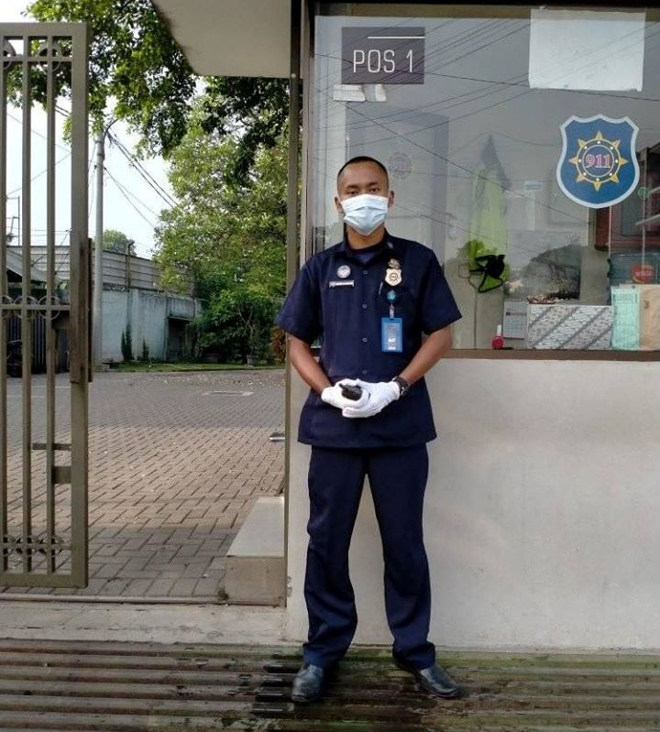
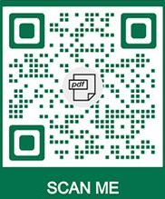
04 Safety Features
Went to school 08.30
Arrived at school 08.45
Book Ride for Casey
QR Safe Landing
Scheduled RIde
School or places could put QR code that can match the position of driver dan code to confirming the arrival.
People can schedule the commute for their kids, or appointment to hospital for grandparents.

Slide 11
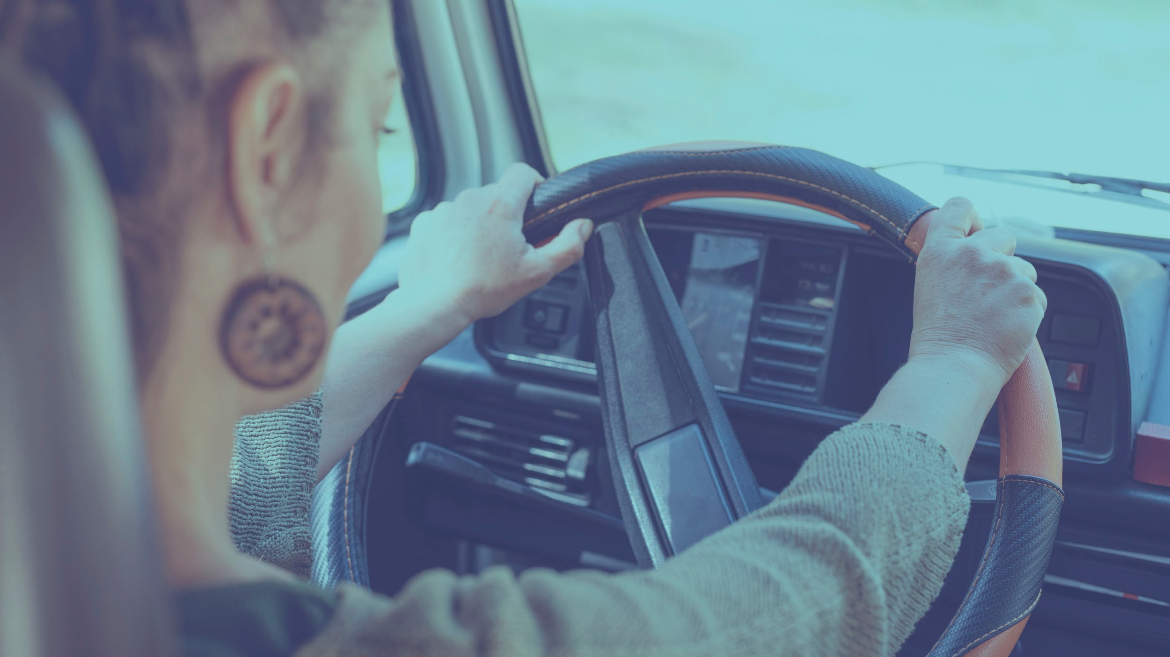
With SFLS the ride-hailing services could be much safer for family.

Slide 12

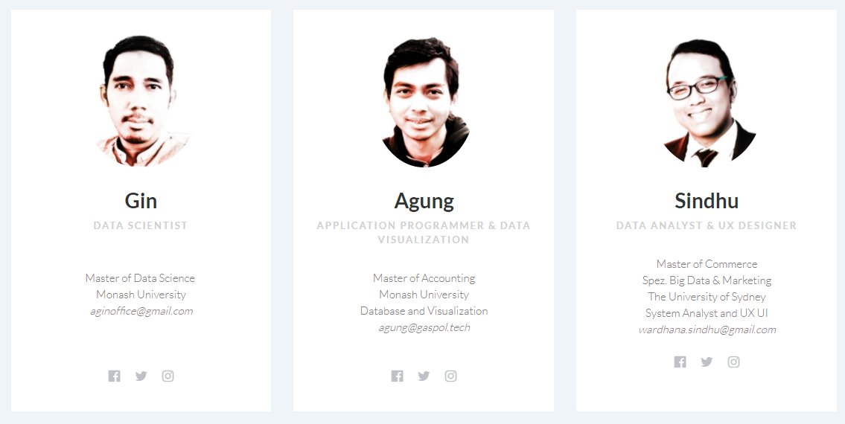

Programmer
Product Manager
Analyst

